Slide 1


ECEN 403
Implementing a GRU based network to detect stock prices on FPGA
Sean Kwatra
Xavier Fisher
Kevin Sipple
Sponsor: Sambandh Dhal

Slide 2
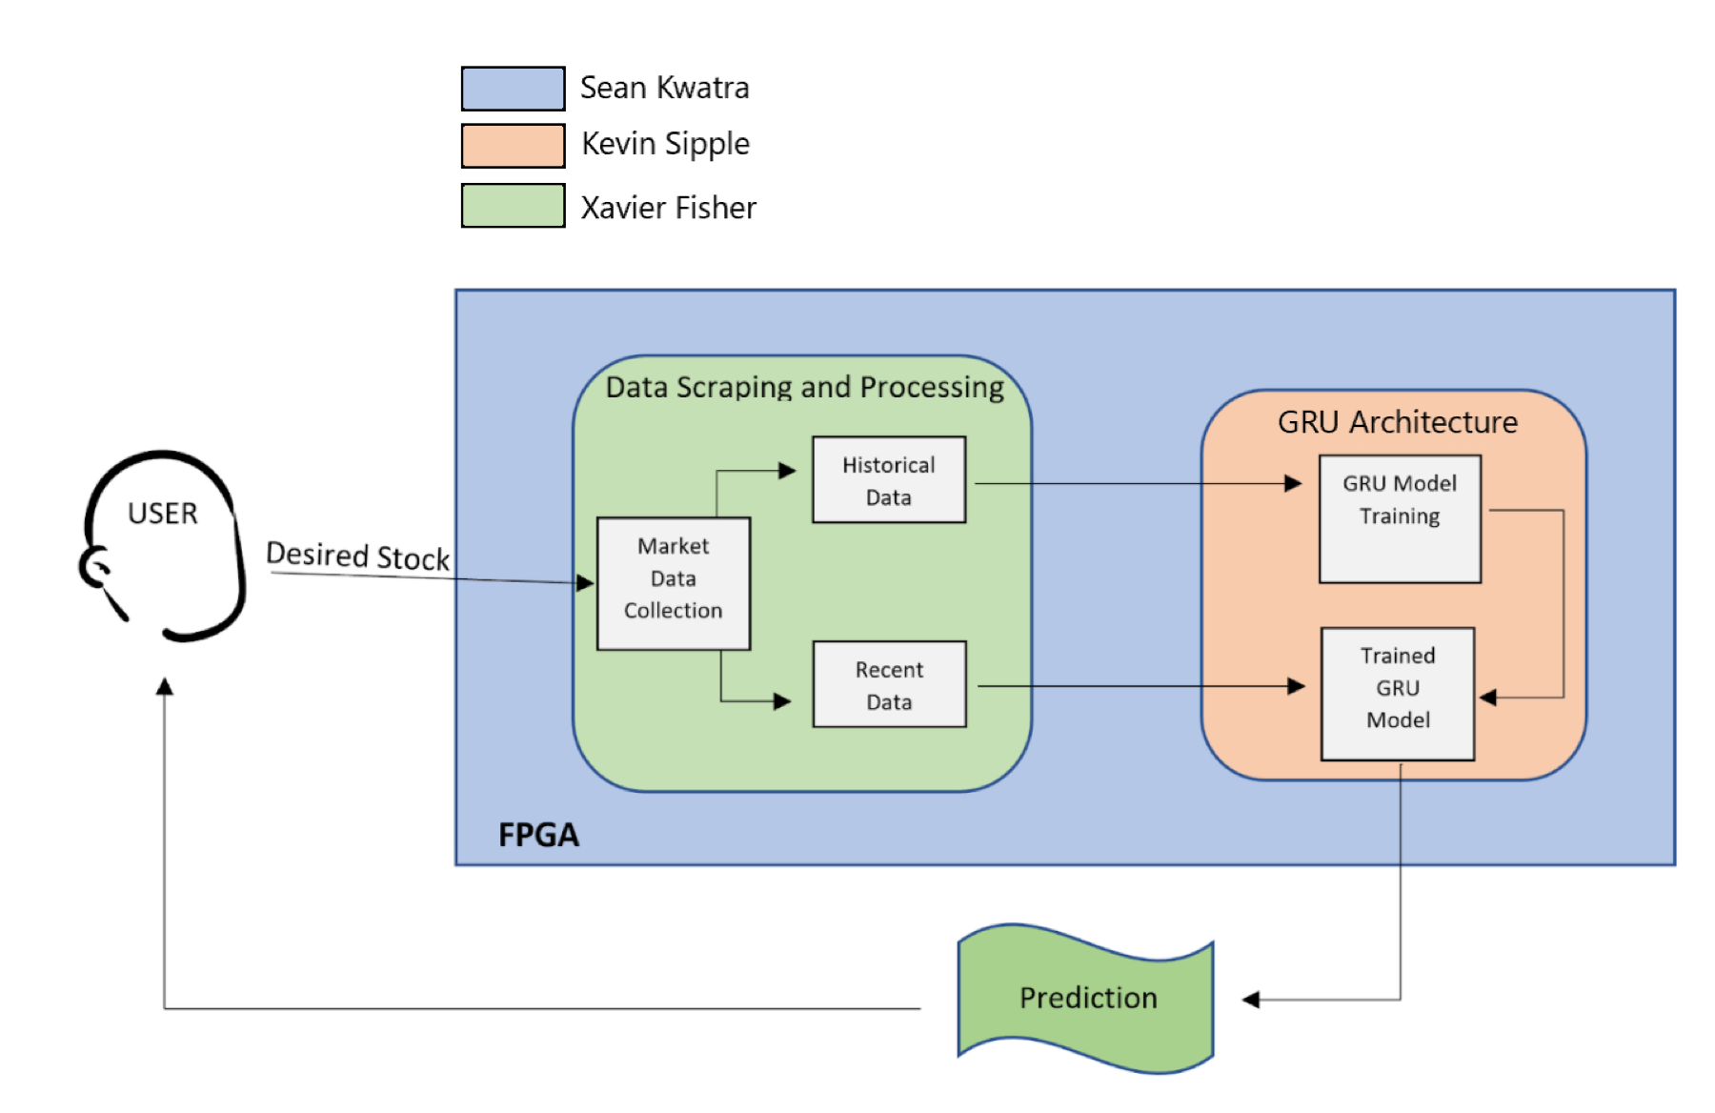
System Overview
Notes:
Run through what is happening here… Discuss each system as an introduction. Then cover the steps of its operation

Slide 3
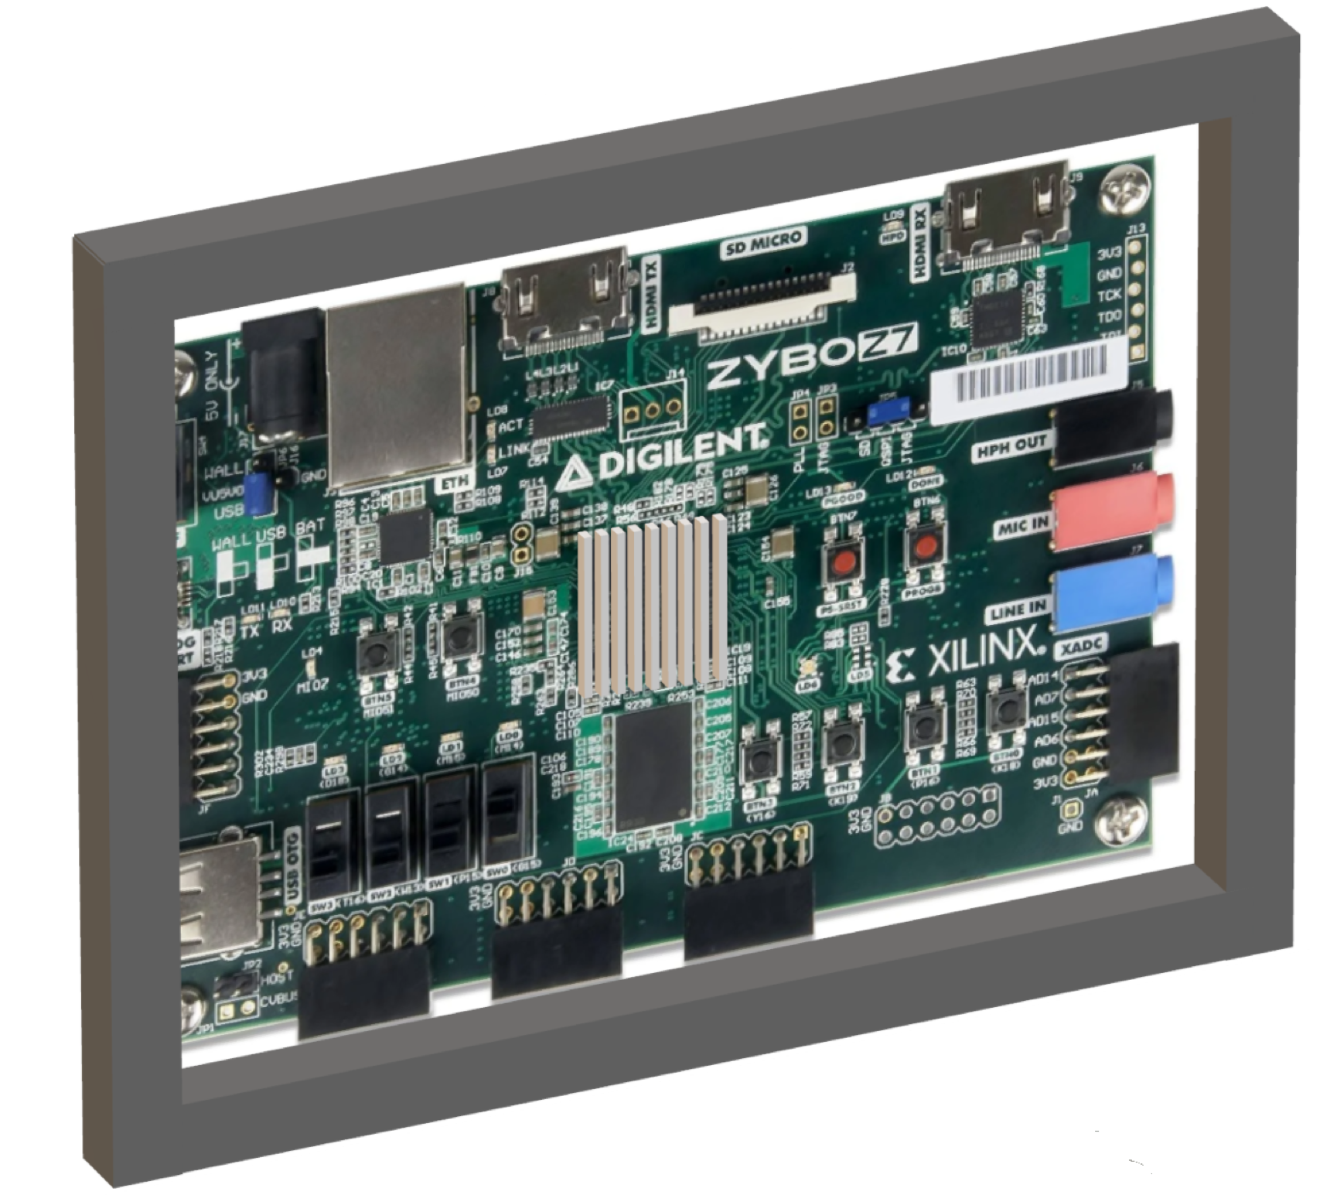
FPGA Subsystem
Conceptual Design
Uses newly installed Linux OS capable of running Python programs
Connects to the internet to obtain data
Will have a cooling system installed
Will have a protective case created and mounted
Subject to Change

Slide 4
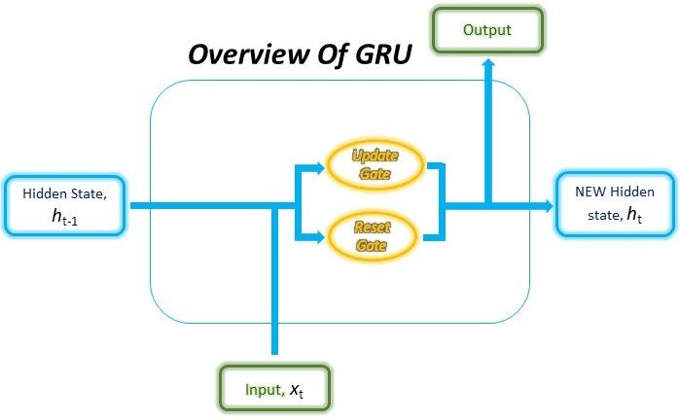
GRU Architecture Subsystem
GRU’s functionality is based on two internal gates
Update Gate
Reset Gate
Minimization of required training for accurate results
Mixing types of data
network size and layers
Source: Gabriel Loye, https://blog.floydhub.com/gru-with-pytorch/

Slide 5

Data Scraping and Processing Subsystem
Data types:
Primary market data
Data such as: total volume, open, close, high and low prices for trade day
Secondary market data.
This subset includes insider buy/sale ratio and EPS
External factors
Such as google trends data, market sentiment, and doomsday sentiment will be considered

Slide 6
Execution and Validation
 | February 28th | March 13th | March 27th | April 10th
GRU Architecture | Download Keras GRU library and generate a small test network | Generate multidimensional arrays of different data combinations | Test different layer numbers and neuron numbers | Test performance, accuracy, and FPGA compatibility
FPGA | Have all parts ordered and shipped. | Start Designing case and install cooling system | Fully install and test the embedded Linux | Fully design and print case and mount onto FPGA
Data Scraping and Processing | Collect and verify primary collected market data is correct | Validate secondary collected market data | Ensure external factors are assessed effectively | All designed programs set up and debugged

